Slide 1
Modelling and Optimizing an Energy System
Görkem Güngör
E-mail: ggungor@enerji.gov.tr

Slide 2
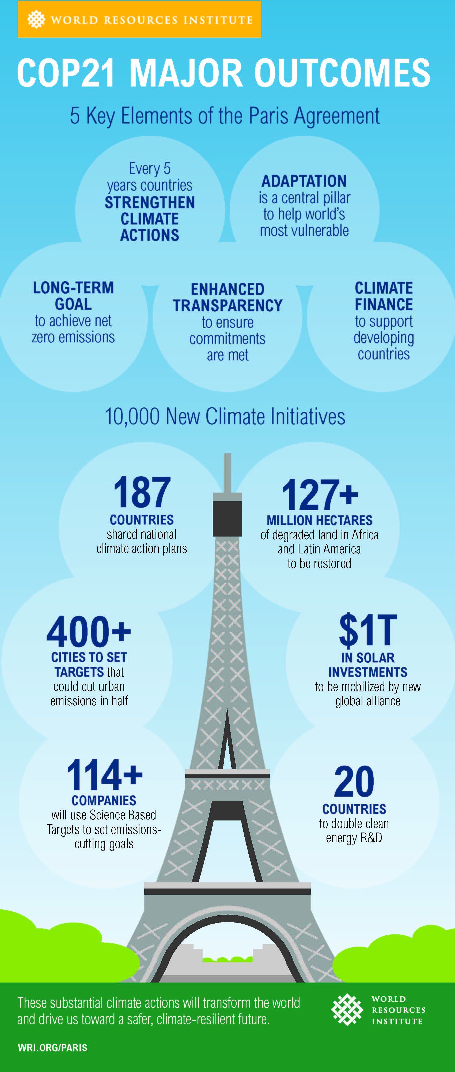
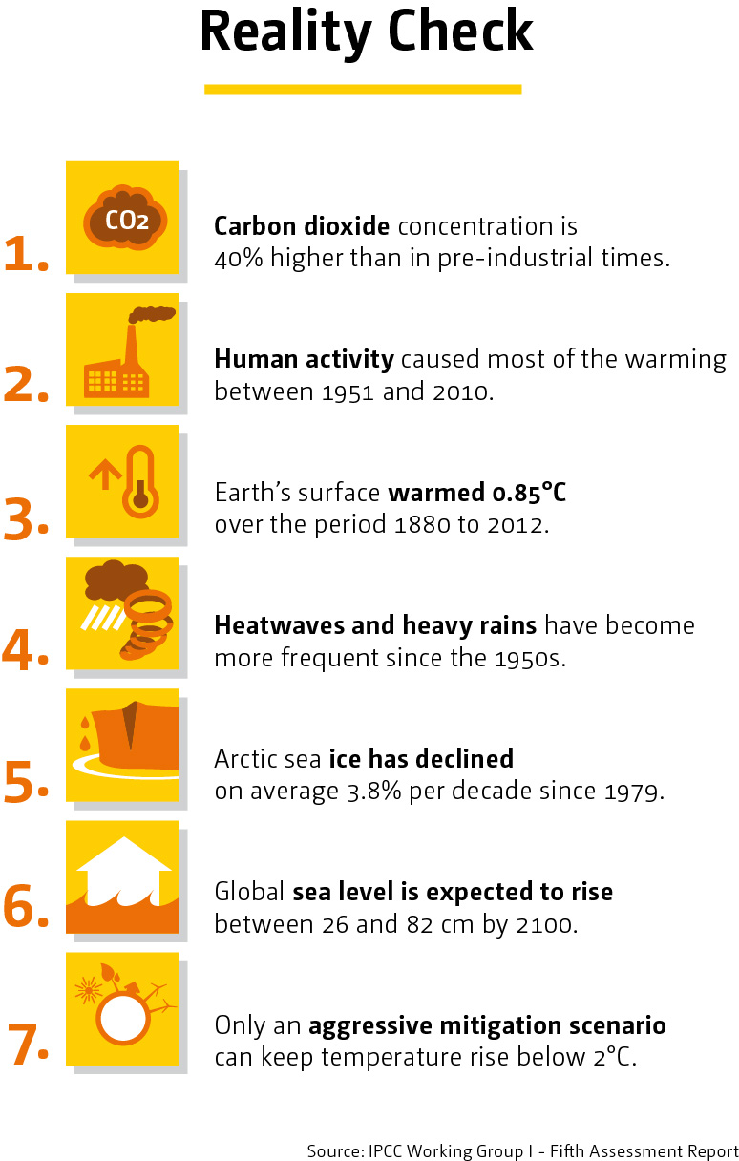
Climate Action
Notes:
https://www.connect4climate.org/infographics/paris-agreement-turning-point-climate-solution

Slide 3
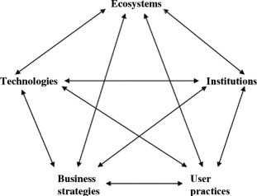
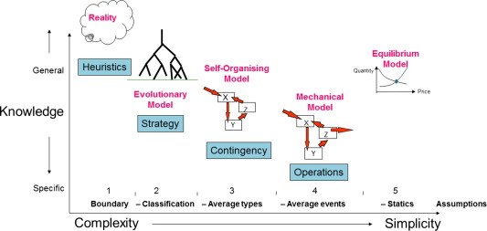
Abstraction and Fidelity
Technologies – energy conversion, supply and end-use technologies.
Institutions – social rule systems relating to policy, planning, risk, investment.
Business strategies – different business models, such as energy utility or energy service company.
User practices – social practices relating to heating, cooking, cleaning and appliance use.
Ecosystems – impacts on local air quality, noise and land use, and global carbon emissions.
Notes:
Bale, C. S. E., Varga, L., & Foxon, T. J. (2015). Energy and complexity: New ways forward. In Applied Energy. https://doi.org/10.1016/j.apenergy.2014.10.057

Slide 4








Poll: Background and experience with scientific programming

Slide 5



Interdisciplinary Framework
Programming skills
Knowledge in
maths and statistics
Expertise in
energy economics
and climate change
Danger zone
Machine learning
Scientific programming
Traditional research
Notes:
http://drewconway.com/the-lab

Slide 6
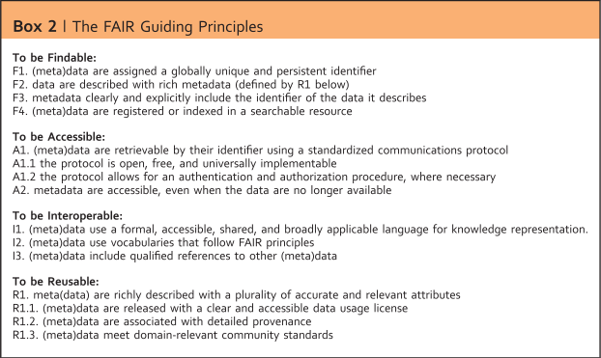
Scientific Data Management
FAIR Guiding Principles:
Findable
Accessable
Interoperable
Reusable
Who is your main (and usually worst) collaborator?
Why is it a bad idea to use data or software that does not have a license?
Why should you share data and code under a license?
Notes:
Osesm-tuwien
Wilkinson, M. D., Dumontier, M., Aalbersberg, Ij. J., Appleton, G., Axton, M., Baak, A., Blomberg, N., Boiten, J.-W., da Silva Santos, L. B., Bourne, P. E., Bouwman, J., Brookes, A. J., Clark, T., Crosas, M., Dillo, I., Dumon, O., Edmunds, S., Evelo, C. T., Finkers, R., … Mons, B. (2016). The FAIR Guiding Principles for scientific data management and stewardship. Scientific Data, 3(1), 160018. https://doi.org/10.1038/sdata.2016.18

Slide 7
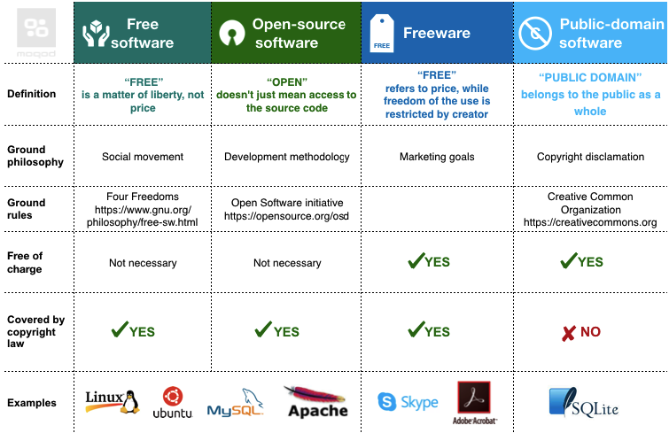
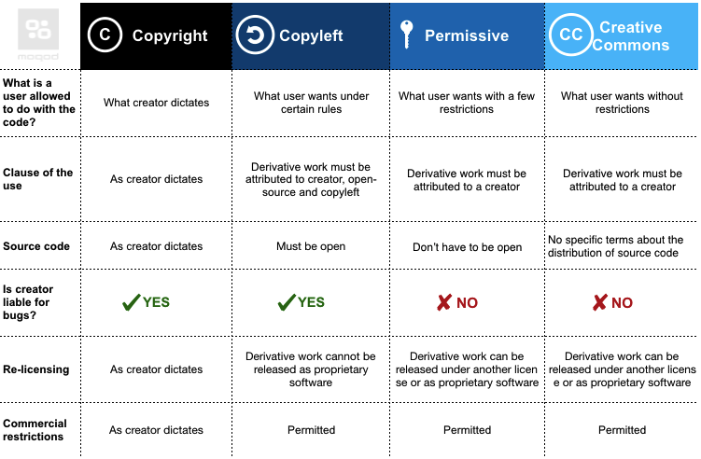

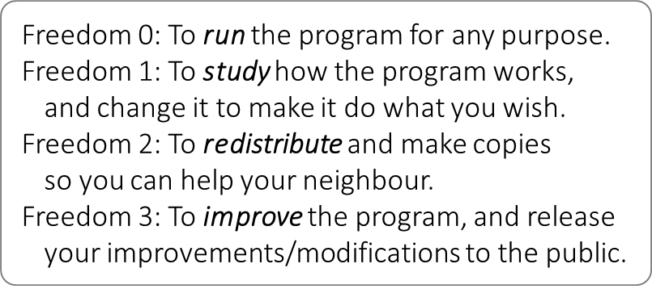
Open Scientific Programming
To find out which license is appropriate for your project: choosealicense.com
Who is your main (and usually worst) collaborator?
Why is it a bad idea to use data or software that does not have an open license?
Why should you share data and code under an open-source license?
Notes:
Osesm-tuwien
https://twiki.org/cgi-bin/view/Blog/BlogEntry201207x1
https://moqod-software.medium.com/understanding-open-source-and-free-software-licensing-c0fa600106c9

Slide 8
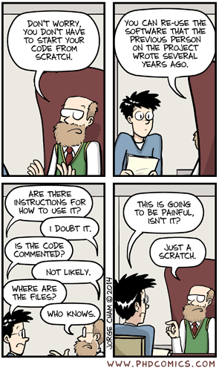
Transparency and Reproducibility
“It is not common practice to publish the computer code”
“People will pick holes and demand support and bug fixes”
“The code is valuable intellectual property that belongs to my institution”
“It is too much work to polish the code and write documentation for publication”
Notes:
Barnes, N. (2010). Publish your computer code: it is good enough. Nature, 467(7317), 753–753. https://doi.org/10.1038/467753a
https://www.software.ac.uk/blog/2016-09-26-irreproducible-research-some-top-tips

Slide 9
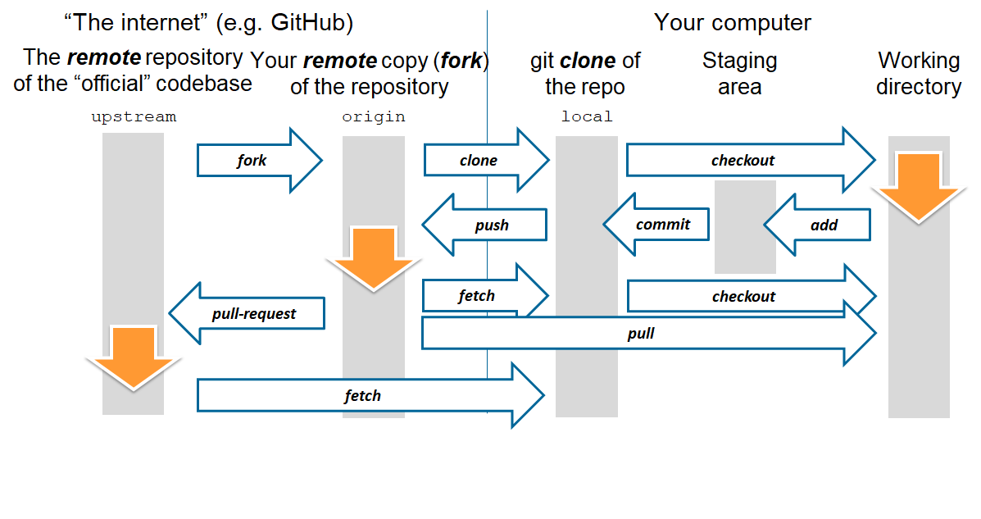
Collaborative Research
Data management: saving both raw and intermediate forms, documenting all steps, creating tidy data amenable to analysis.
Software: writing, organizing, and sharing scripts and programs used in an analysis.
Collaboration: making it easy for existing and new collaborators to understand and contribute to a project.
Project organization: organizing the digital artifacts of a project to ease discovery and understanding.
Tracking changes: recording how various components of your project change over time.
Manuscripts: writing manuscripts in a way that leaves an audit trail and minimizes manual merging of conflicts.
Notes:
Wilson, G., Bryan, J., Cranston, K., Kitzes, J., Nederbragt, L., & Teal, T. K. (2017). Good enough practices in scientific computing. PLOS Computational Biology, 13(6), 1–20. https://doi.org/10.1371/journal.pcbi.1005510
https://cbea.ms/git-commit/

Slide 10

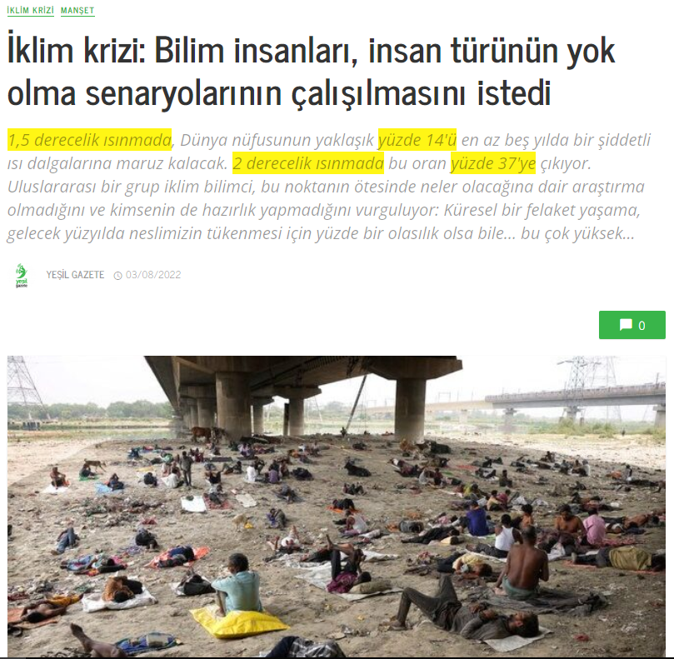
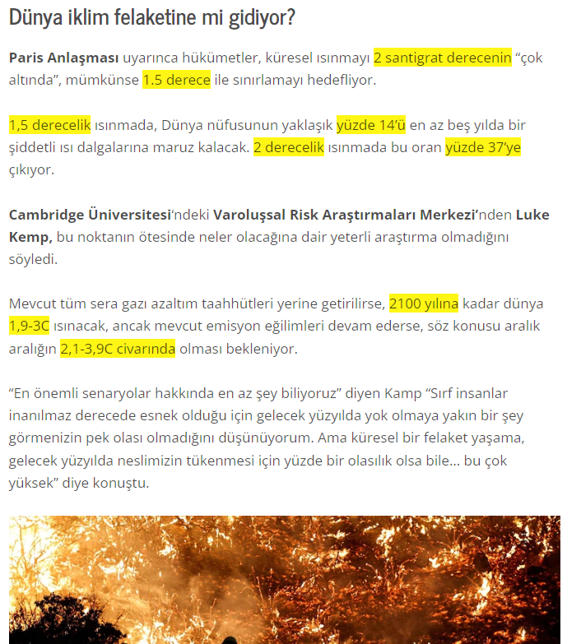
IPCC Reports
Notes:
https://yesilgazete.org/iklim-krizi-bilim-insanlari-insan-turunun-yok-olma-senaryolarinin-calisilmasini-istedi/

Slide 11
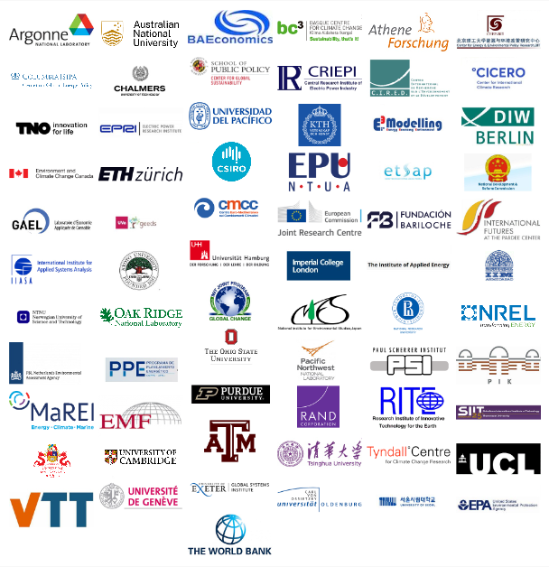


Integrated Assessment Modeling Consortium
Created in 2007 in response to a call from the IPCC for a research organization to lead the IAMC in the development of new scenarios
Share of community dataset, software and presentation materials

Slide 12
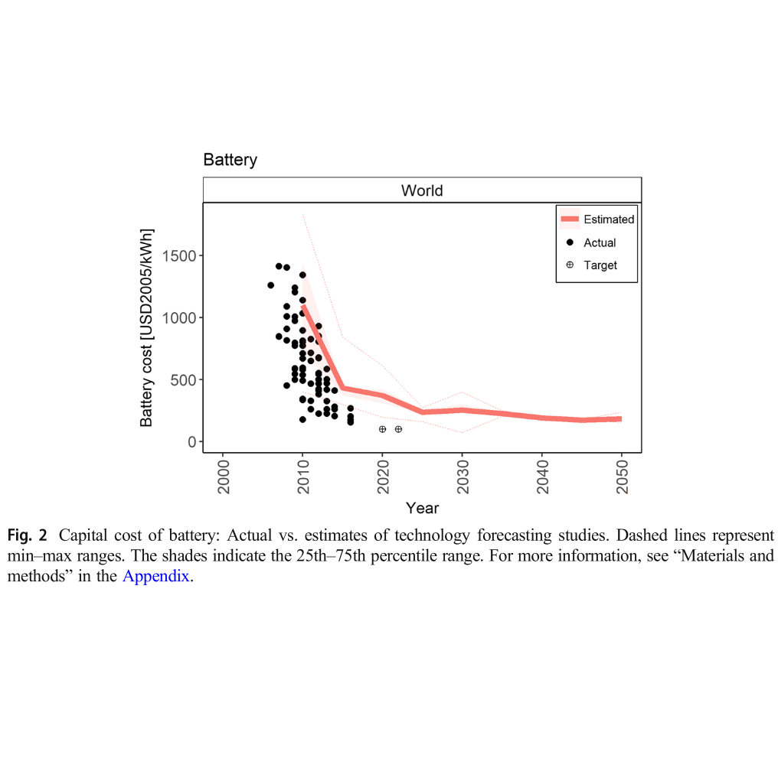
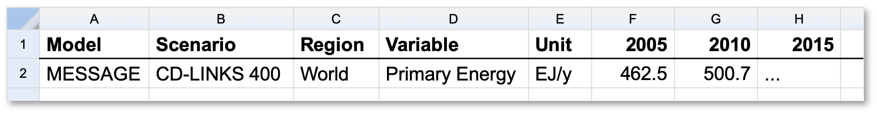
IPCC AR5 Scenarios
MIPs | Year | Number of Models | Number of Scenarios | Areas | Lead Institutions
LIMITS | 2014 | 7 | 84 | Mitigation policies | FEEM
POeM | 2012 | 1 | 4 |  | Chalmers University of Technology
RECIPE | 2009 | 2 | 18 |  | PIK
AME | 2012 | 16 | 83 | Mitigation policy | PNNL
RoSE | 2013 | 3 | 105 | Mitigation policy; GDP growth; population growth, fossil fuel availability | PIK
ADAM | 2009 | 1 | 15 | Technology availability, Mitigation policy | PIK
EMF 22 | 2009 | 7 | 70 |  | Stanford University
EMF 27 | 2013 | 16 | 362 |  | Stanford University
AMPERE | 2013 | 11 | 378 | Technology availability; mitigation policy; GDP; population | PIK
Majority of the scenarios provided by Model Intercomparison Projects (MIPs)
AR5 participants include 31 models (sometimes in different versions) and 1,184 scenarios
IAMC uses tabular data for easy comparison
Models should be carefully employed to mitigate model-real discrepancy for rapidly changing technologies
Notes:
https://tntcat.iiasa.ac.at/AR5DB/dsd?Action=htmlpage&page=about
Shiraki, H., & Sugiyama, M. (2020). Back to the basic: toward improvement of technoeconomic representation in integrated assessment models. Climatic Change, 162(1), 13–24. https://doi.org/10.1007/s10584-020-02731-4

Slide 13
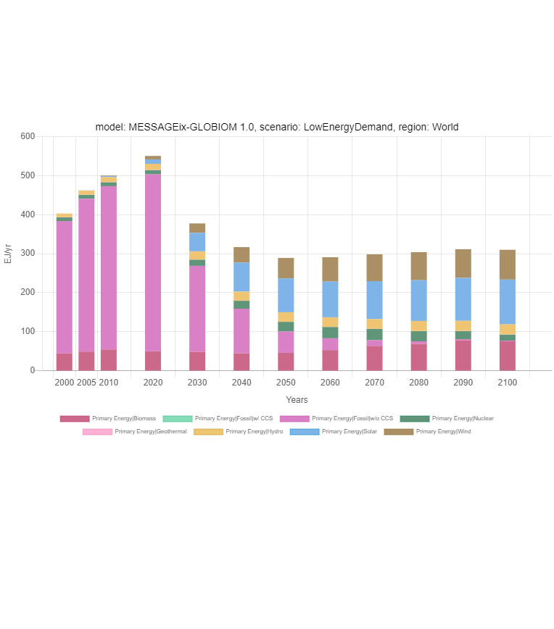
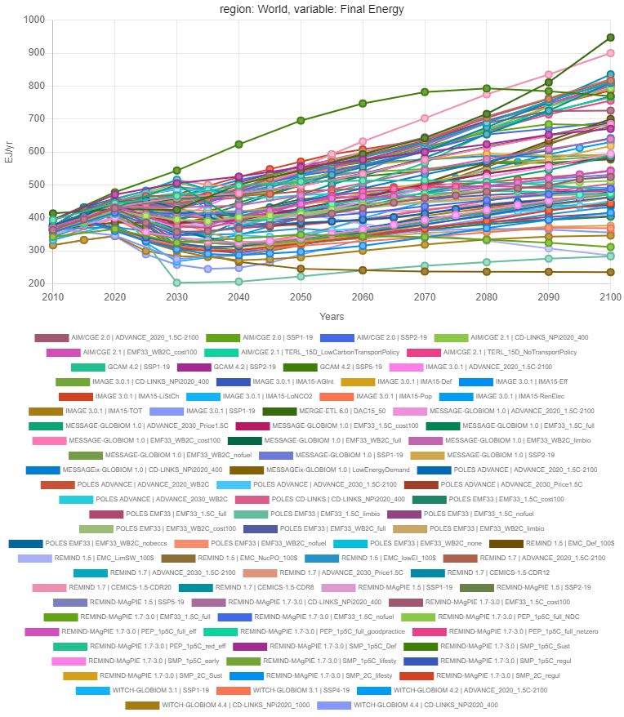
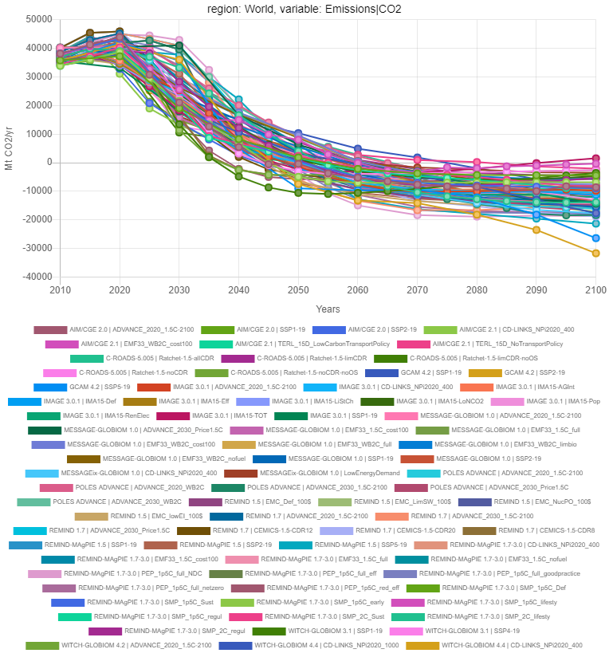
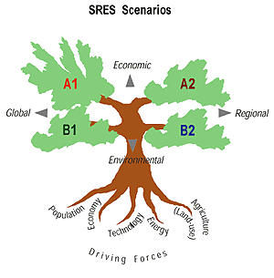
IPCC SR15 Scenarios
"Special Report on Global Warming of 1.5°C" (SR15) published by the Intergovernmental Panel on Climate Change (IPCC) in 2018
Global CO2 emissions for 78 scenarios
Global final energy demand depend on socio-economic assumptions for 90 scenarios
Low Energy Demand (LED) scenario reduces supply side investments with socio-economical transition of useful energy demand
Notes:
https://data.ece.iiasa.ac.at/iamc-1.5c-explorer/#/license
Grubler, A., Wilson, C., Bento, N., Boza-Kiss, B., Krey, V., McCollum, D. L., Rao, N. D., Riahi, K., Rogelj, J., De Stercke, S., Cullen, J., Frank, S., Fricko, O., Guo, F., Gidden, M., Havlík, P., Huppmann, D., Kiesewetter, G., Rafaj, P., … Valin, H. (2018). A low energy demand scenario for meeting the 1.5 °C target and sustainable development goals without negative emission technologies. Nature Energy, 3(6), 515–527. https://doi.org/10.1038/s41560-018-0172-6

Slide 14
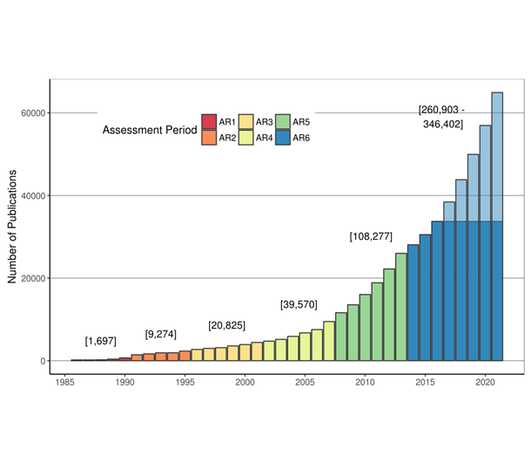
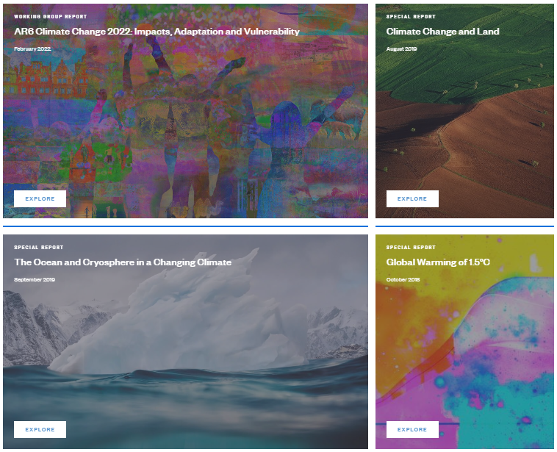
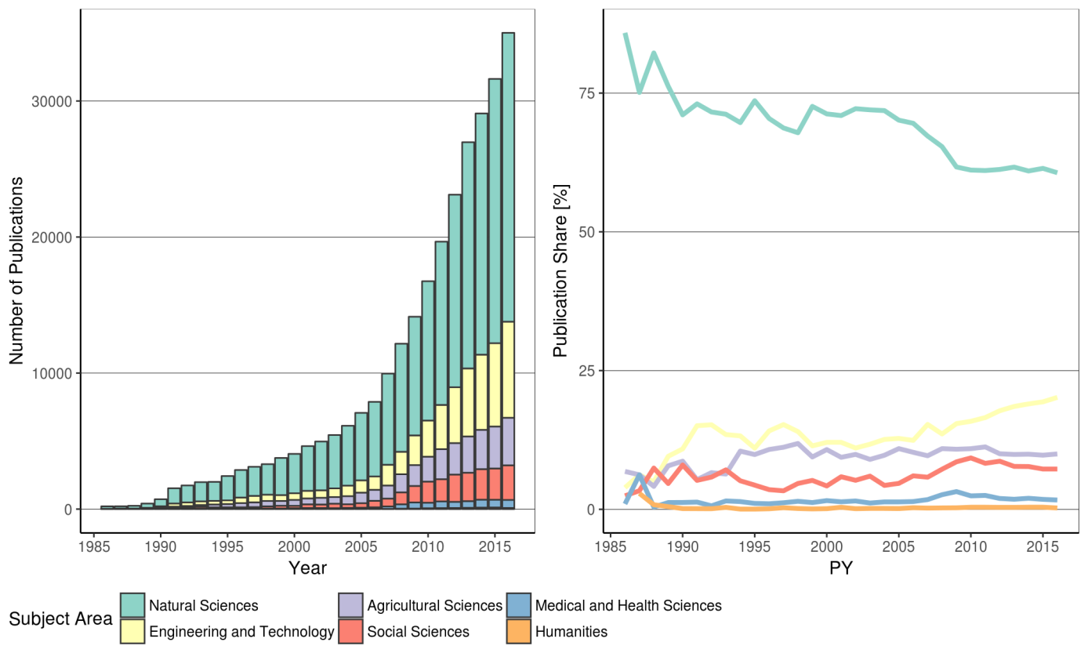
IPCC AR6 Scenarios
WGI examines the physical science of climate change
WGII assesses the impacts of climate change, vulnerability of human societies and natural and options for adaptation
WGIII assesses methods for reducing GHG emissions and removing GHGs from atmosphere
Synthesis Report integrates WGs and the findings from Special Reports
Expanding and diversifying literature requires innovative methods
Notes:
https://www.ipcc.ch/outreach-material/
https://www.ipcc.ch/working-group/wg2/
Minx, J. C., Callaghan, M., Lamb, W. F., Garard, J., & Edenhofer, O. (2017). Learning about climate change solutions in the IPCC and beyond. Environmental Science & Policy, 77(May), 252–259. https://doi.org/10.1016/j.envsci.2017.05.014

Slide 15
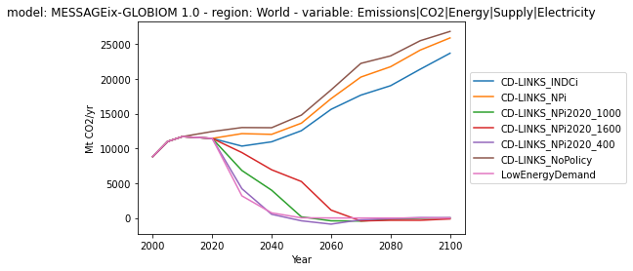
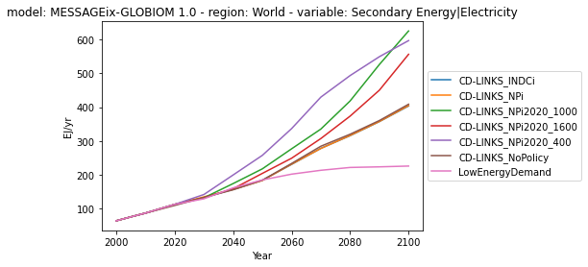
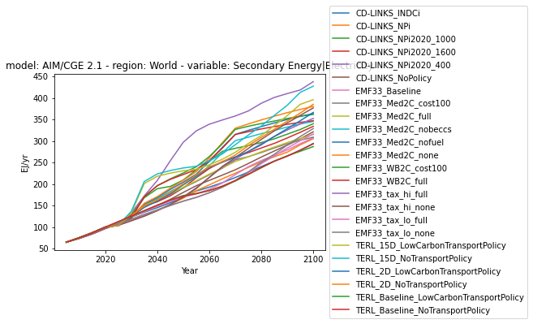
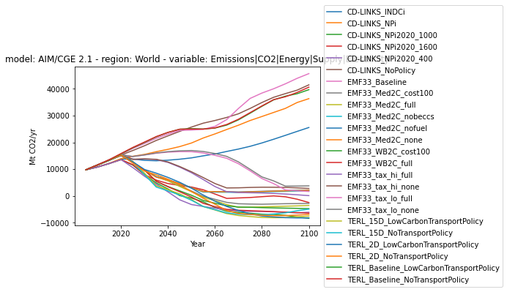
Data Visualization
Synthesis of results using an open-source analysis and visualization library – Jupyter notebook
Share climate data analysis in IAMC community for greater transparency and reproducibility
Pyam has facilitated increased coordination and consistency across the analysis and data processing steps in IPCC AR6
Notes:
Gidden, M., & Huppmann, D. (2019). pyam: a Python Package for the Analysis and Visualization of Models of the Interaction of Climate, Human, and Environmental Systems. Journal of Open Source Software, 4(33), 1095. https://doi.org/10.21105/joss.01095
Huppmann, D., Gidden, M. J., Nicholls, Z., Hörsch, J., Lamboll, R., Kishimoto, P. N., Burandt, T., Fricko, O., Byers, E., Kikstra, J., Brinkerink, M., Budzinski, M., Maczek, F., Zwickl-Bernhard, S., Welder, L., Álvarez Quispe, E. F., & Smith, C. J. (2021). pyam: Analysis and visualisation of integrated assessment and macro-energy scenarios. Open Research Europe, 1, 74. https://doi.org/10.12688/openreseurope.13633.2

Slide 16
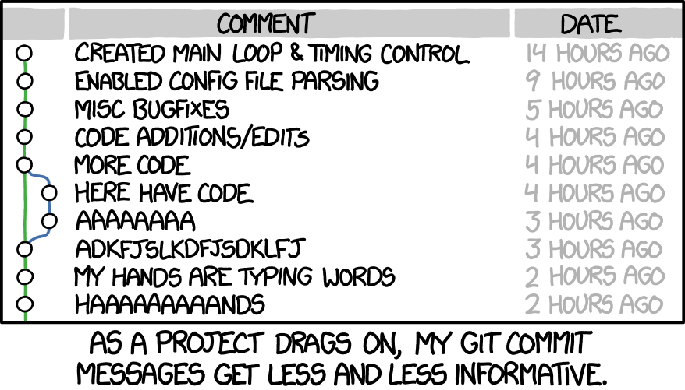
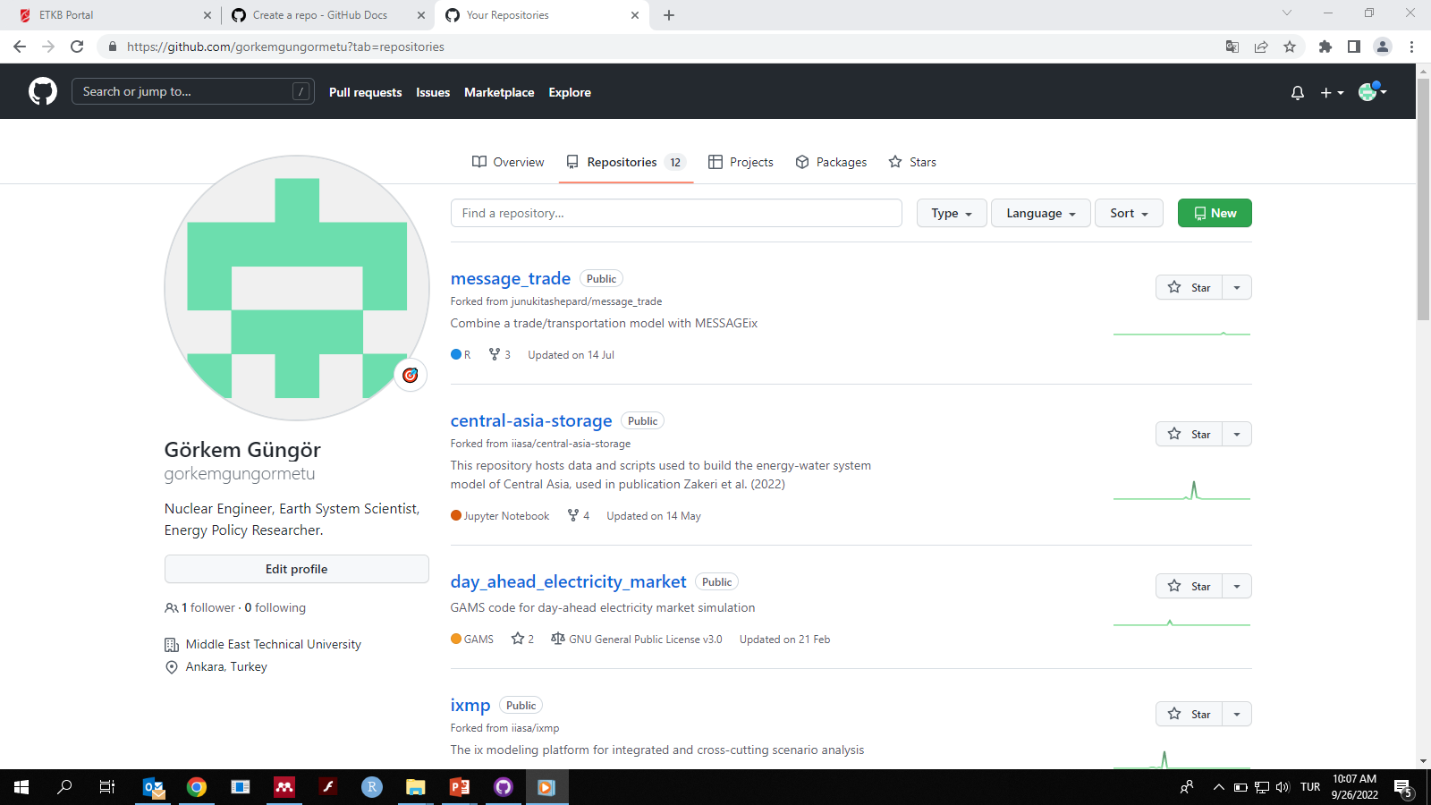
Git Database
Git provides decentralized version control instead of synchronization (Dropbox, Google Drive)
Commitments should be accepted for changes in the master documents
Similar to write-copying the notebook of your friend where you both continue seperately afterwards
Finally you can compare your notebooks and make commits for revised version (minor or major)
Notes:
https://github.com/gorkemgungormetu?tab=repositories
https://cbea.ms/git-commit/

Slide 17
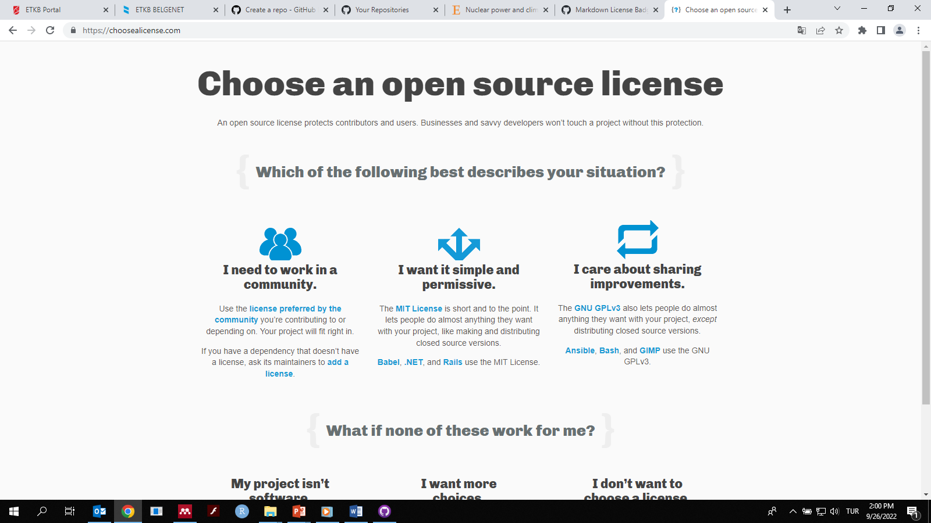
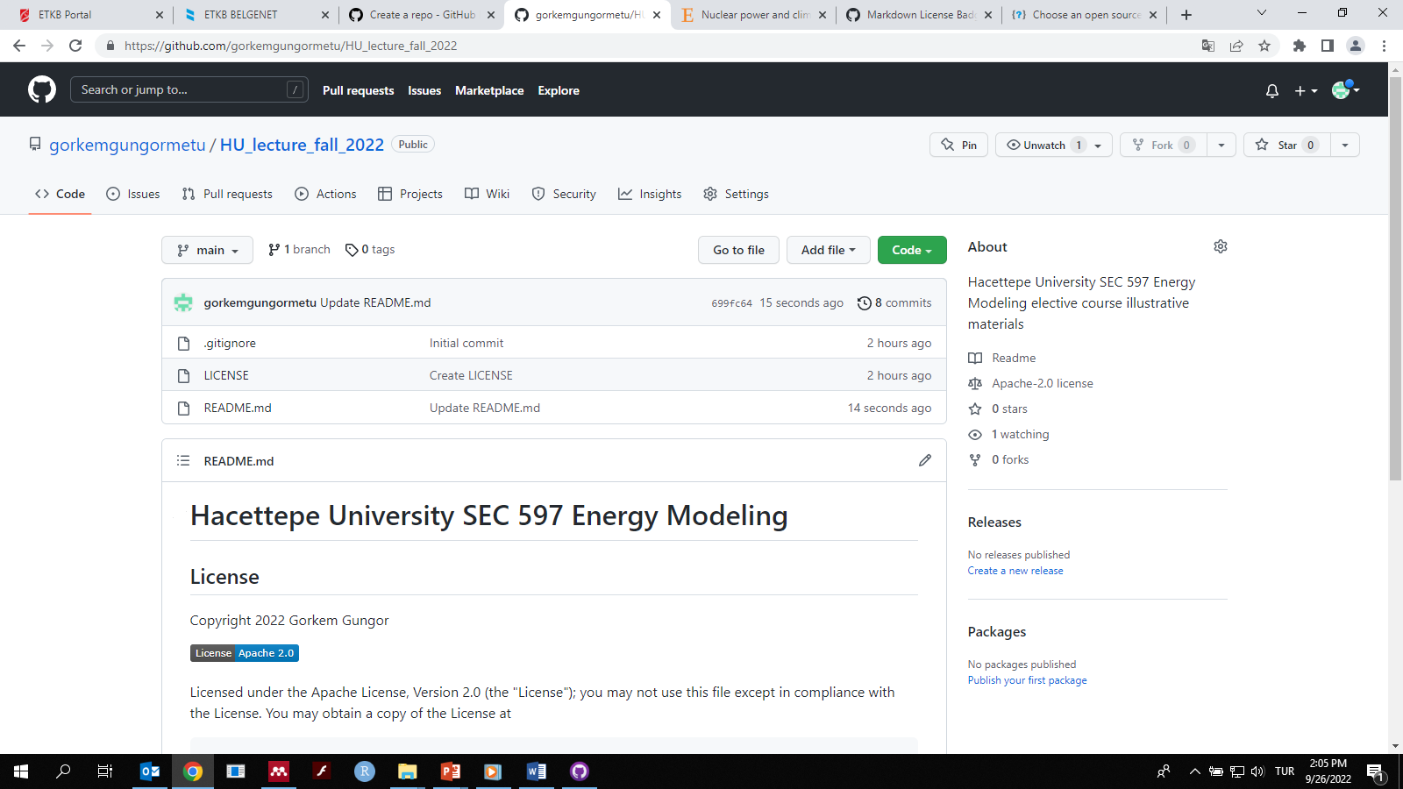
Licensing
Choose a license to claim your rights for owning, sharing and liabilities
The type of license which suits you depends on your work and collaboration
Choose a badge of your license at the start-up page of your repository to look professional and cool
Creative Commons license might be better for data sharing, whereas Apache and MIT provides permissive open-source license useful for software development
Notes:
https://choosealicense.com/
https://gist.github.com/lukas-h/2a5d00690736b4c3a7ba

Slide 18
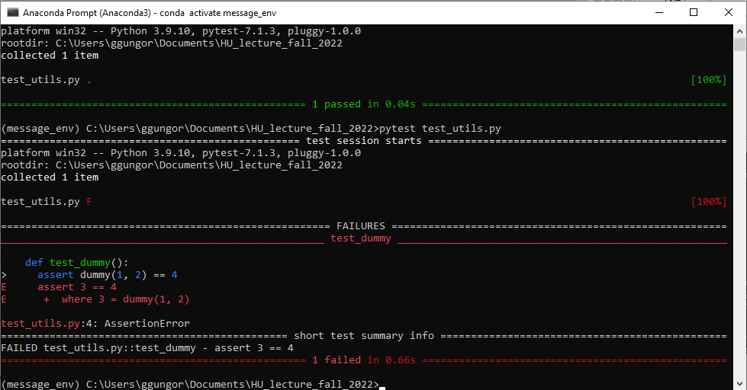
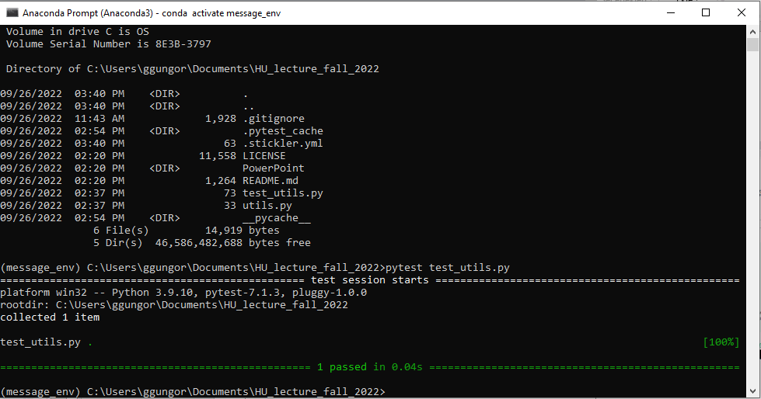
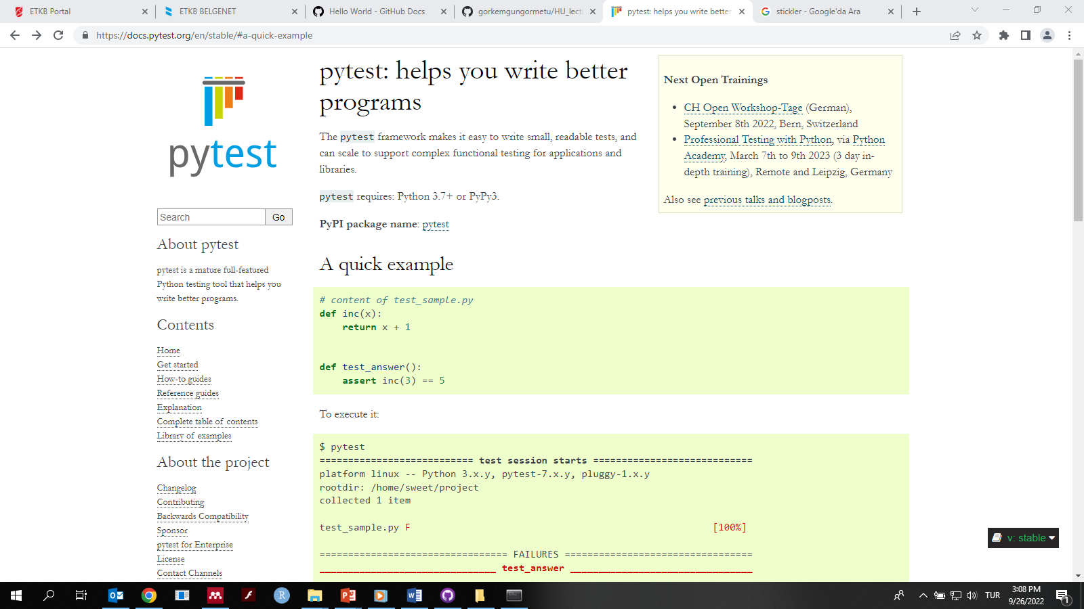
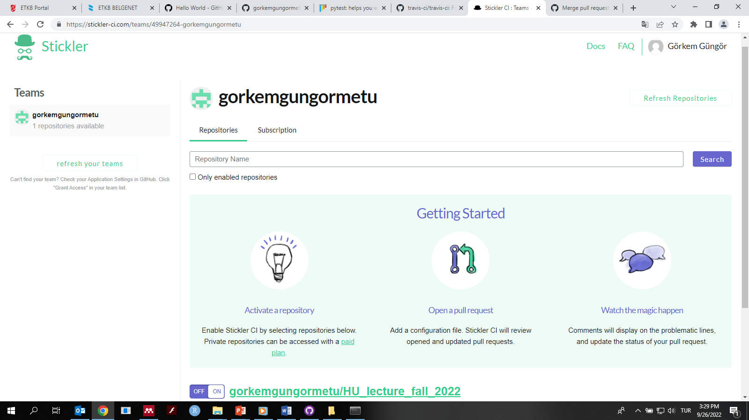
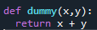
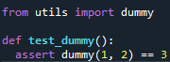
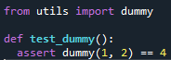
Control Features
Test your programs and functions to receive expected outputs integrating merges from collaborators
Automated or stand-alone program reviewing and diagnosis using linters in YML code
Notes:
https://docs.pytest.org/en/stable/#a-quick-example

Slide 19
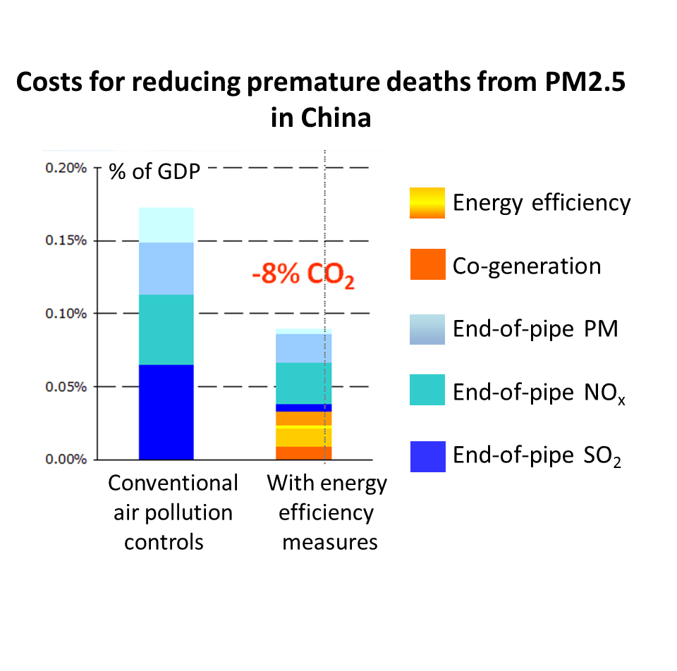
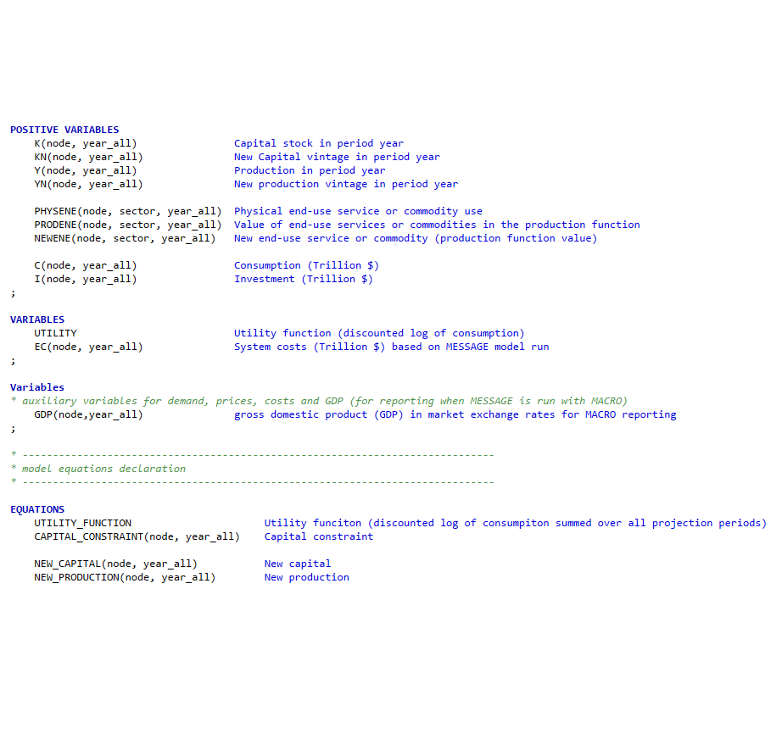
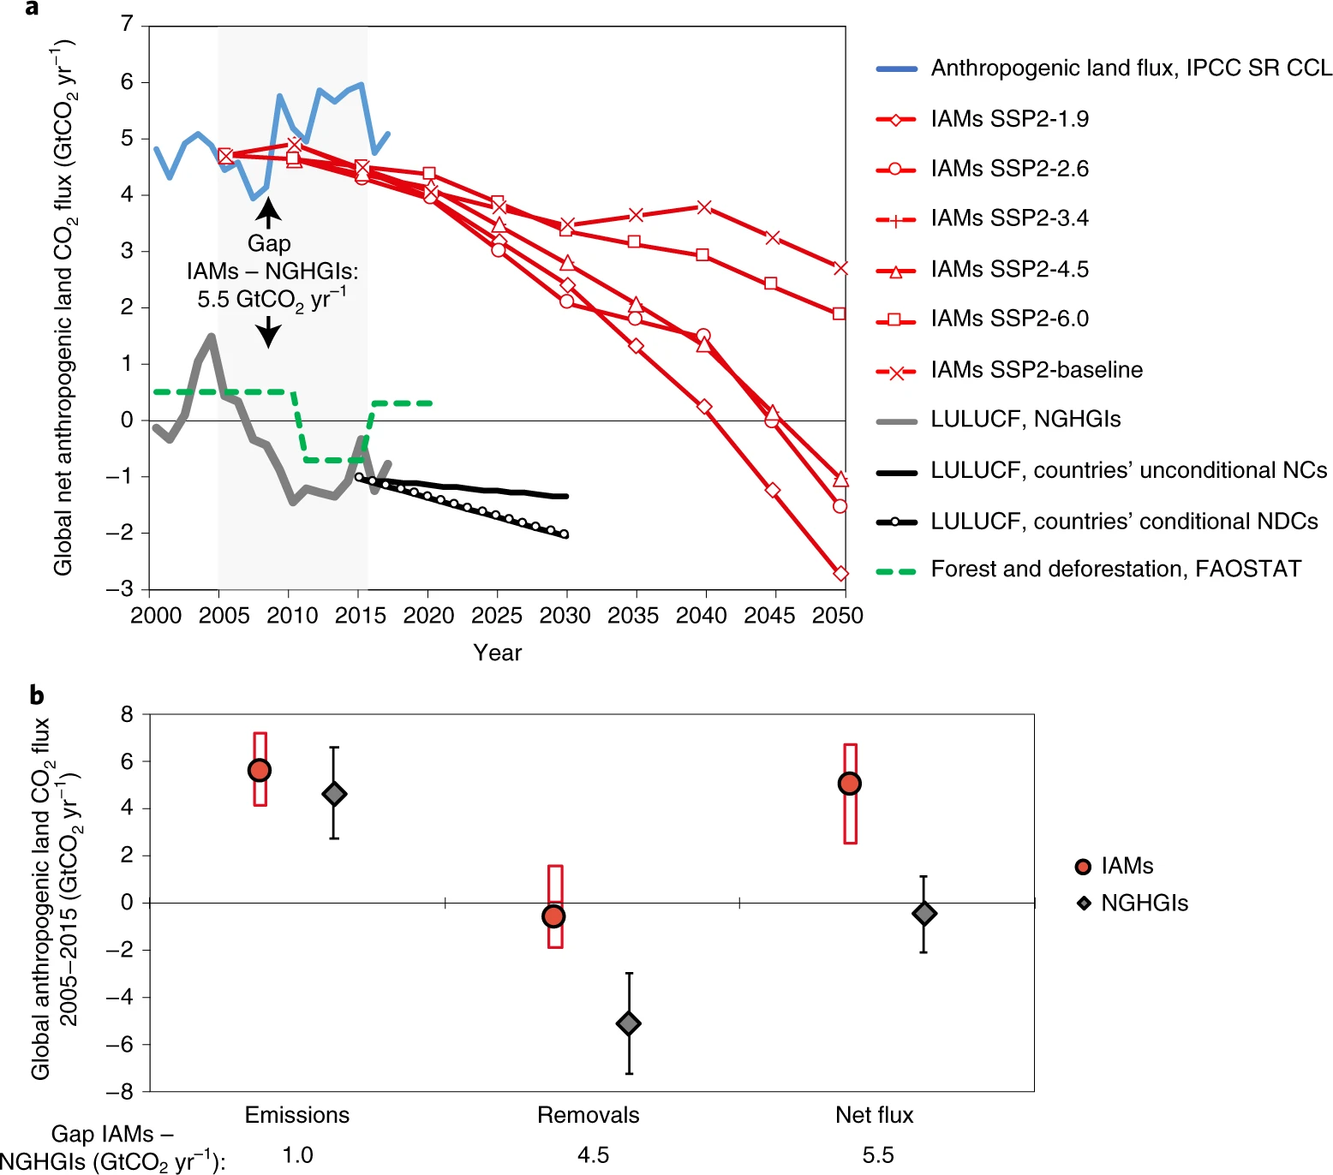
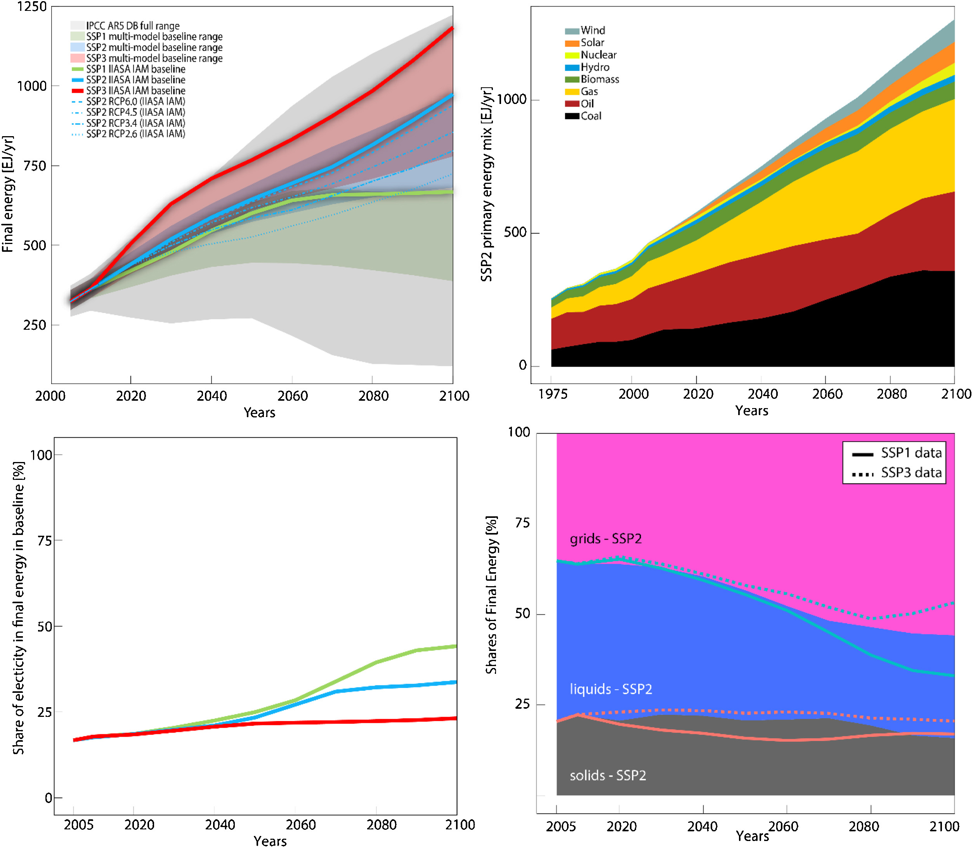
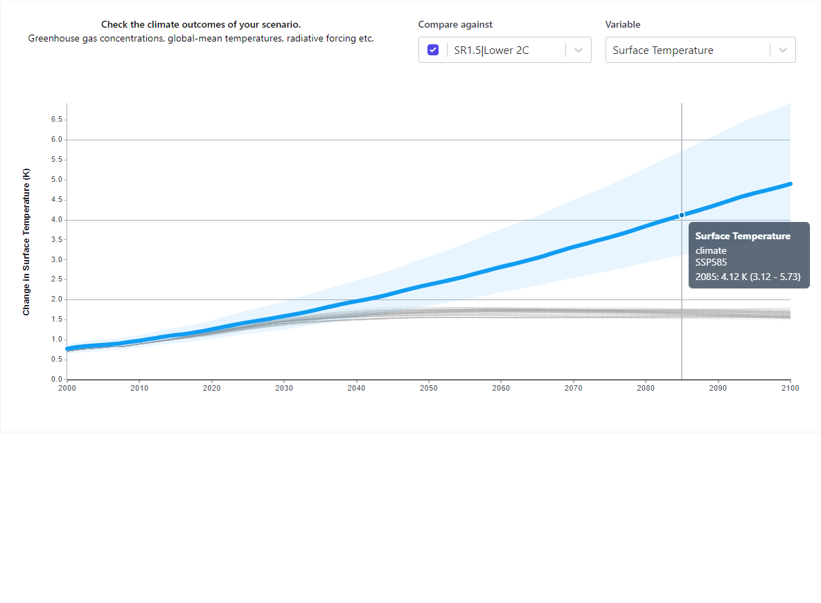
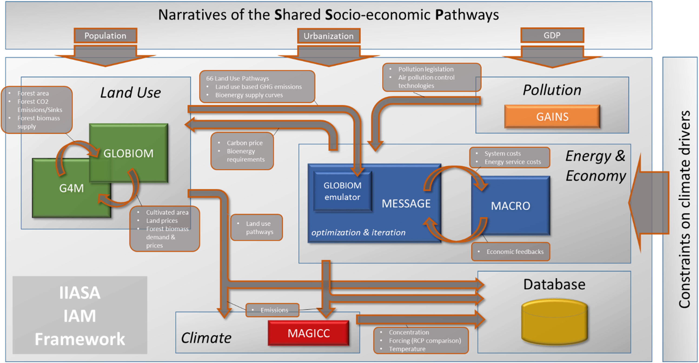
IIASA Modeling Framework
MESSAGE for long term inter-regional energy system planning
GLOBIOM is a dynamic partial-equilibrium model for land use (agriculture, forestry,biofuels)
GAINS is emissions scenario tool covering six GHGs of the Kyoto Protocol
MACRO represents the global economy with single consumer-producer in each region
MAGICC includes the climate scenarios used by the IPCC
Notes:
Fricko, O., Havlik, P., Rogelj, J., Klimont, Z., Gusti, M., Johnson, N., Kolp, P., Strubegger, M., Valin, H., Amann, M., Ermolieva, T., Forsell, N., Herrero, M., Heyes, C., Kindermann, G., Krey, V., McCollum, D. L., Obersteiner, M., Pachauri, S., … Riahi, K. (2017). The marker quantification of the Shared Socioeconomic Pathway 2: A middle-of-the-road scenario for the 21st century. Global Environmental Change, 42, 251–267. https://doi.org/10.1016/j.gloenvcha.2016.06.004
Grassi, G., Stehfest, E., Rogelj, J., van Vuuren, D., Cescatti, A., House, J., Nabuurs, G.-J., Rossi, S., Alkama, R., Viñas, R. A., Calvin, K., Ceccherini, G., Federici, S., Fujimori, S., Gusti, M., Hasegawa, T., Havlik, P., Humpenöder, F., Korosuo, A., … Popp, A. (2021). Critical adjustment of land mitigation pathways for assessing countries’ climate progress. Nature Climate Change, 11(5), 425–434. https://doi.org/10.1038/s41558-021-01033-6
https://gains.iiasa.ac.at/models/index.html
The Kyoto protocol covers six categories of greenhouse gas (GHG) emissions: carbon dioxide (CO2), methane (CH4), nitrous oxide (N2O), hydrofluorocarbons (HFCs), perfluorocarbons (PFCs) and sulphurhexafluoride (SF6)
https://docs.messageix.org/en/latest/model/MACRO/macro_core.html

Slide 20
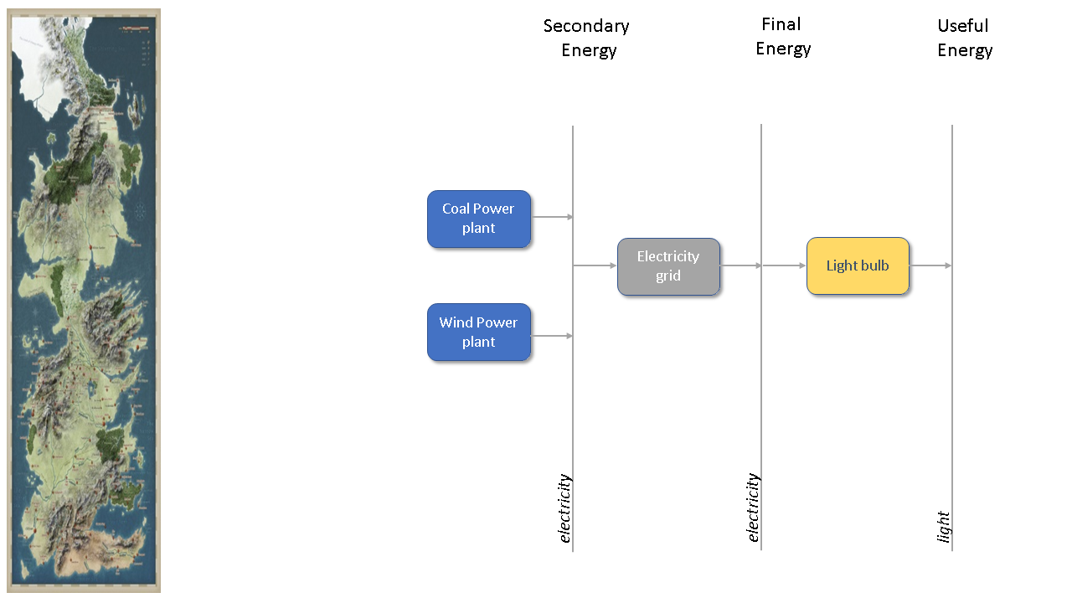
Baseline Energy System - Westeros
Notes:
This example is based on the Westeros Tutorial - Introduction to the MESSAGEix framework: Creating a baseline scenario.

Slide 21

Model Structure
The model horizon spans three decades (690-720)
Far in the future after the events of A Song of Ice and Fire (which occur ~300 years after Aegon the conqueror)
The discount ratio is 5% per year
Notes:
https://awoiaf.westeros.org/index.php/Aegon%27s_Conquest

Slide 22
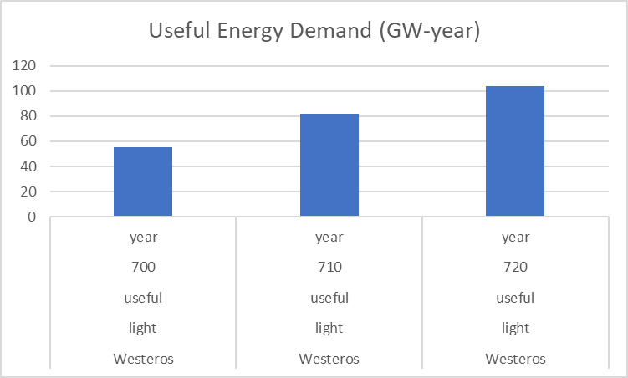
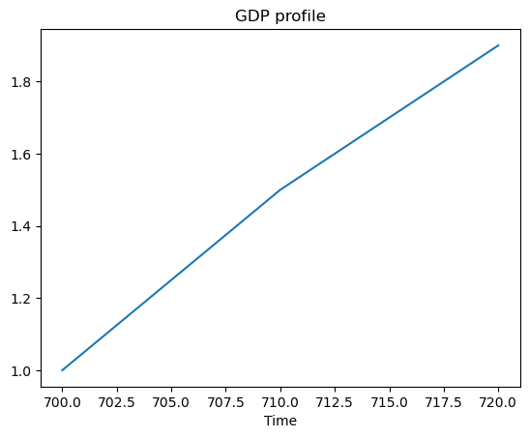
Energy Demand
Demand for electricity is correlated with production
GDP profile is similar to first world historical profiles in the beginning of the 20th century
Model assumptions:
40 million people in 300 AC
Similar population growth to Earth in the same time frame (~factor of 12)
A per capita demand for electricity of 1000 kWh

Slide 23
Technology Parameters
Activity costs | USD / kWyr
Electricity grid | 50
Coal power plant | 30
Technology | Main input | Main output | Efficiency
Light bulb | Elec./Final | Light/Useful | 1
Grid | Elec./Secon. | Elec./Final | 0.9
Coal_ppl |  | Elec./Secon
Wind_ppl |  | Elec./Secon
Investment costs | USD / kW
Light bulb | 5
Coal power plant | 500
Wind power plant | 1500
Historical capacity addition | MW/year
Light bulb | 12224 (690-699)
Coal power plant | 2685 (680-699)
Wind power plant | 4755 (680-699)
Fixed costs | USD / kW/yr
Coal power plant | 30
Wind power plant | 10
Operating lifetime | Years
Light bulb | 10
Coal power plant | 20
Wind power plant | 20
Capacity factor | Share
Wind power plant | 0.36

Slide 24
Historical Capacity
Electricity generation from coal and wind power plants
New capacity needs to be created to replace the retiring capacity and meet increasing demand
New capacity is created only when the investment cost is defined
Reference year capacity | MW
Light bulb | 55008
Coal_ppl | 38932.5
Wind_ppl | 68947.5

Slide 25
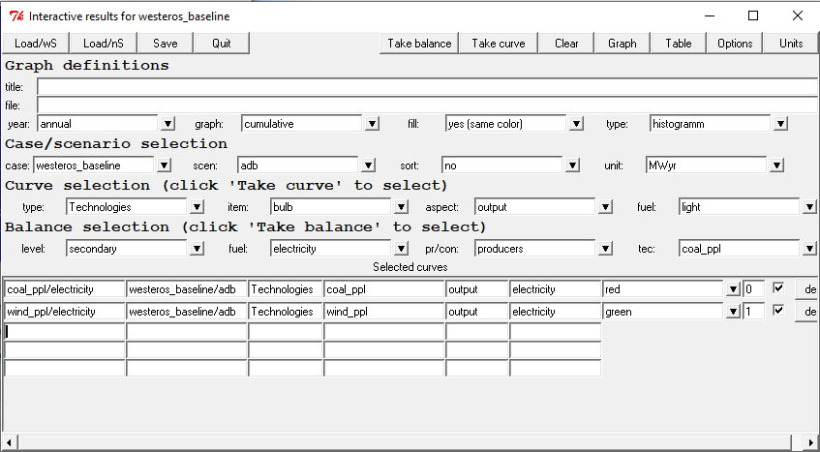
Running the Problem
Select the «adb» scenario from «Select -> scenario
Generate the lineer programming matrix from «Run -> mxg»
Run the optimization solver from «Run -> opt»
Select the «Results -> interactive» screen to see the results in tables and graphs
Rows | 49 | Equations
Cols | 16 | Variables
Elms | 116 | Parameters
Rhs | 21 | Right hand side constraints
Bnds | 2 | Constant bounds

Slide 26
Visualization of Results
Secondary Electricity
Total installed capacity

Slide 27

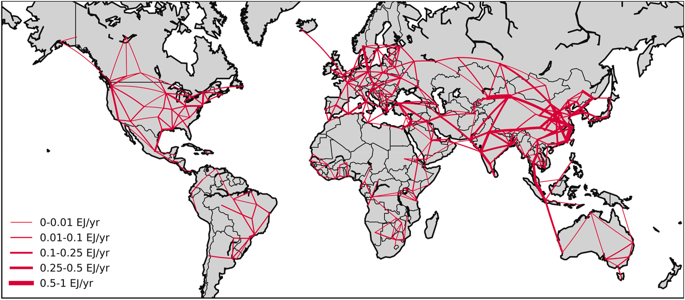
Modeling Bias
Capacity factor of wind power plant is taken as efficiency
Renewable energy generation is intermittent and predictable with scientific advancement
Renewable power is characteristically different than baseload generation
More realistic representation of spatial and temporal resolution
Curtailment requirements might favor renewable energy expansion
Notes:
Brinkerink, M., Zakeri, B., Huppmann, D., Glynn, J., Ó Gallachóir, B., & Deane, P. (2022). Assessing global climate change mitigation scenarios from a power system perspective using a novel multi-model framework. Environmental Modelling and Software, 150(January). https://doi.org/10.1016/j.envsoft.2022.105336
https://power.larc.nasa.gov/docs/

Slide 28
References
[1] Bale CSE, Varga L, Foxon TJ. Energy and complexity: New ways forward. Applied Energy. 2015 .
[2] Wilkinson MD, Dumontier M, Aalbersberg IjJ, Appleton G, Axton M, Baak A, et al. The FAIR Guiding Principles for scientific data management and stewardship. Sci Data [Internet]. 2016. 3(1):160018.
[3] Barnes N. Publish your computer code: it is good enough. Nature [Internet]. 2010. 467(7317):753–753.
[4] Wilson G, Bryan J, Cranston K, Kitzes J, Nederbragt L, Teal TK. Good enough practices in scientific computing. PLOS Comput Biol [Internet]. 2017. 13(6):1–20.
[5] Shiraki H, Sugiyama M. Back to the basic: toward improvement of technoeconomic representation in integrated assessment models. Clim Change [Internet]. 2020. 162(1):13–24.
[6] Grubler A, Wilson C, Bento N, Boza-Kiss B, Krey V, McCollum DL, et al. A low energy demand scenario for meeting the 1.5 °C target and sustainable development goals without negative emission technologies. Nat Energy [Internet]. 2018. 3(6):515–27.
[7] Minx JC, Callaghan M, Lamb WF, Garard J, Edenhofer O. Learning about climate change solutions in the IPCC and beyond. Environ Sci Policy [Internet]. 2017. 77(May):252–9.
[8] Gidden M, Huppmann D. pyam: a Python Package for the Analysis and Visualization of Models of the Interaction of Climate, Human, and Environmental Systems. J Open Source Softw [Internet]. 2019. 4(33):1095.
[9] Huppmann D, Gidden MJ, Nicholls Z, Hörsch J, Lamboll R, Kishimoto PN, et al. pyam: Analysis and visualisation of integrated assessment and macro-energy scenarios. Open Res Eur. 2021. 1:74.
[10] Fricko O, Havlik P, Rogelj J, Klimont Z, Gusti M, Johnson N, et al. The marker quantification of the Shared Socioeconomic Pathway 2: A middle-of-the-road scenario for the 21st century. Glob Environ Chang [Internet]. 2017. 42:251–67.
[11] Brinkerink M, Zakeri B, Huppmann D, Glynn J, Ó Gallachóir B, Deane P. Assessing global climate change mitigation scenarios from a power system perspective using a novel multi-model framework. Environ Model Softw. 2022. 150(January).

